Slide 1
Credit card defaulters
By Kurama teja

Slide 2
Abstract:-
Whether customer is going to default the credit card payment or not, it is necessary to bank such that it can generate much interest if credit card payment is done on time. It is a classification methodology whether they are defaulters or non-defaulters. Based on the forecast it will try to come up with strategics to both payers and non-payers to cope with such situation and limit it is risk taking ability. Such that with the help of this model building the bank can know the actual defaulters.

Slide 3
Aim:-
Whether the person is going to default the credit card payment or not.
DATA SHARING AGREEMENT:-
Before starting any project there will be an data sharing agreement between both the parties such that it need to include all the details and it carry according in that specific manner it follows:-
Name validation:- try to validate the name in particular file name if that criteria does not satisfy, we will try to drop that file.
Number of columns:- As per DSA we will try to check whether we are getting same set of columns even if the client try to send the new dataset.
Name of column: it should contain the same name as per the schema file.
Null values in columns:- if it contains null values in particular it need to be mentioned in that DSA itself, otherwise we will notify the client and dump that file as it not mentioned in DSA.

Slide 4
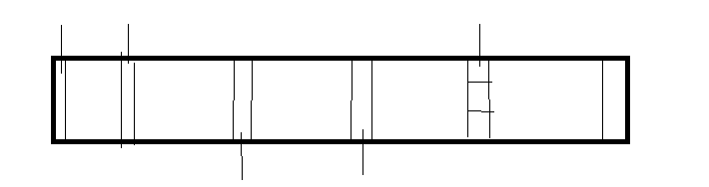
Pipeline:-
Build an model splits
Try to build an system from one end it is going to inject an data on the first layer it will try to check the file name is good or not. It is just rough pipeline to understand it we have drawn it into our convince.
Suppose while building the model we will try to send the data to respective cluster or model. maybe perform clustering or grouping operation over there.
Similar for the test data we need to perform the same pipeline.
this pipeline need to perform on single click with an everything need to be generated (not looking for manual intervention just looking for automation..
File name
Default or not
File level
check
production
Data level check
Data transformation
Training Dataset

Slide 5
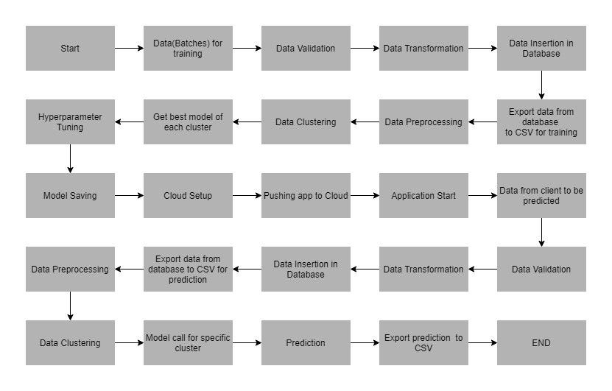
Architecture:-

Slide 6
Data Description:-
Client will send data in multiple sets of data in batches at a given location. The data has been extracted from census bureau.
Data contains 32561 instances with following attributes:-
features:-
Limit_bal:- continuous credit limit of the person.
Sex:- categorical: 1= male , 2= female
Education:- categorical: 1= graduate school, 2=university, 3=high school , 4= others.
Marriage: 1= married , 2= single, 3= others.
Age: num= continuous
Pay_0 to Pay_6:- history of past payment. We tracked the past monthly payments records (from April to septmember,2009)
Bill_amt1 to Bill_amt6:- amount of bill statements.
Pay_amt1 to Pay_amt6:- amount of previous payments.

Slide 7
Data insertion into Database:-
1) Database Creation and connection - Create a database with the given name passed. If the database is already created, open the connection to the database.
2) Table creation in the database - Table with name - "Good_Data", is created in the database for inserting the files in the "Good_Data_Folder" based on given column names and datatype in the schema file. If the table is already present, then the new table is not created and new files are inserted in the already present table as we want training to be done on new as well as old training files.
3) Insertion of files in the table - All the files in the "Good_Data_Folder" are inserted in the above-created table. If any file has invalid data type in any of the columns, the file is not loaded in the table and is moved to "Bad_Data_Folder

Slide 8
Model Training:-
Before proceeding to the model training we must do data validation it contains of two types mainly validation and actual training.
In validation we do the following steps:-
Whether the number of columns are same or not.
File name format
Replacing the Na values with null.
Replacing the single code to double code.
Once this steps are performed then it will try to do the actual training.
In actual training the following steps are taken place:-
Data pre-processing
Feature selection/column
Missing values.
Categorical to numerical

Slide 9
Cont.…
We will try to pull all the data from database where it will insert all the good data folder and the bad data folder it will automatically pull out.
in data pre-processing with do the following steps:-
We will try to find the missing values, there is no missing values in these datasets
Convert the categorical to numerical values, but here there is no need to do all these since all the values in numerical itself.
Convert imbalanced to balanced dataset.
Since there is high correlation in certain features among themselves but we will try to keep those values as it since they might incur certain loss of data.
Then we are going to select clustering part for these features suppose we divided into 3 sets, here we are going to use k-means clustering to find the way to do it. Here we need to find the k-value. It can be find it out with elbow plot or knee locater.

Slide 10
Cont.…
Based on cluster we are performing grouping . Such that if they are three groups:-
0 - group 0
1 - group 1
2 – group 2
Here individuals machine learning model will be trained for all the groups. Which model performs better we will do hyperparameter tuning for that helps to find out which model is best.
To select which algorithm to select in general we need to perform all algorithm such that it we will better idea since it is classification problem, here for time constraint we have taken only two algorithm over here. Then with that apply hyperparameter tuning to it which gives the best algorithm then select it. Here we are using Xgboost and Naïve baye’s.
Save the model it will use for prediction. With the help of AUC score we are going to select the best algorithm.

Slide 11
Prediction:-
it will go through the entire pipeline such that Name of the files, Length of Date value in Filename, Length of Time value in Filename, Number of Columns, Name of the Columns and their datatype.
we also require a "schema" file from client which contains all the relevant information about the training files.
Based on the cluster number, the respective model is loaded and is used to predict the data for that cluster.
Once the prediction is made for all the clusters, the predictions along with the defaulters names are saved in a CSV file at a given location and the location is returned to the client.
Deployment:-
We will be deploying the model to the Pivotal Cloud Foundry platform.

Slide 12
Questions:-
Q1. Tell me about your current project?
Whether customer is going to default the credit card payment or not, it is necessary to bank such that it can generate much interest if credit card payment is done on time. It is a classification methodology whether they are defaulters or non-defaulters. Based on the forecast it will try to come up with strategics to both payers and non-payers to cope with such situation and limit it is risk taking ability.
Q2. What was the size of the data?
Data contains 32561 instances.
Q3. What was the data type?
Data used for training the model consist of different values of 24 columns, it is converted into two unique values +1 represents Good_Data_Folder while -1 represents Bad_Data_Folder.
Q4. What was the team size and distribution?
1 Product Manager,
1 Solution Architect,
1 Lead
UI developers and Data Scientists

Slide 13
Cont.…
Q5.What was the size of the cluster?
The cluster(production setup) consisted of 15 servers with
Intel i7 processors
56 GB of RAM
500 GB of Secondary storage each
Q6. How many nodes were there in all the Dev, UAT, and Prod environments?
The necessary coding was done on one development server. But as a standalone machine won’t give enough speed to train the model in a short time, once we saw that the model’s loss is decreasing for a few numbers of epochs in the standalone machine, the same code was deployed to a cloud-based GPU machine for training. Once the model was trained there, we used the saved model file for prediction/classification. The same model file was deployed to the cloud UAT and Production environments. In total, we had: • 5 nodes in the dev environment, • 5 nodes in UAT, and • 15 nodes in production

Slide 14
Cont.…
Q7.How were you creating and maintaining the logs?
The logs are maintained using SQLite. The logging starts with the start of the application. The start time of the application gets logged. After that, there are loggings for entry and exits to the individual methods. There are loggings for the error scenarios and exception block as well.
Q8.What techniques were you using for data pre-processing for various data science use cases and visualization?
Perform different steps in the data pre-processing, like data cleaning, data integration and data scaling etc..
We will try to find the missing values, there is no missing values in these datasets
Convert the categorical to numerical values, but here there is no need to do all these since all the values in numerical itself.

Slide 15
Cont.….
Q9. How were you maintaining the failure cases?
Whenever a system sends an file we always keep an nomenclature such if there is any glitch in the system it need to be handled. Such whenever any new data comes from the client it will rectfy if the error if there any and report it.
Q10.What kind of automation have you done for data processing?
Once the clustering is done by auto evaluation technique which model suits best for to predict in this case we have k-means, even the value of k will not be selected by elbow plot but it will try to select automatically to calculate the k-value.
Q11.Have you used any scheduler?
No
Q12.How are you monitoring your job?
There are logging set-ups done. We regularly monitor the logs to see for any error scenarios. For fatal errors, we had email notifications in place. Whenever a specific error code, which has been classified as a fatal error occurs, email gets triggered to the concerned parties.

Slide 16
Cont..
Q13. What were your roles and responsibilities in the project?
My responsibilities consisted of gathering the dataset, labeling the images for the model training, training the model on the prepared dataset, deploying the trained model to the cloud, monitoring the deployed model for any issues, providing QA support before deployment and then providing the warranty support post-deployment.
Q14.What was your day to day task?
My day to day tasks involved collecting any new datasets is available such that to check whether it contains the same format as mentioned in the data sharing agreement and completing the tasks assigned to me, doing the requirement analysis, data validation and unit test for the models. Insertion of data into database or into the schema.
Q15.In which area you have contributed the most?
In data preprocessing I have done most of the work on checking the null values imputer and zero standard deviation and data validation with regard to name validation and number of columns. Also had an discussions how to select the model such that the system will try ro generate or automate itself to select the model

Slide 17
Cont..
Q16.In which technology you are most comfortable?
I have worked in almost all the fields viz. Machine Learning, sql and visualization. I have nearly equivalent knowledge in these fields. But if you talk about personal preference, I have loved working in Machine Learning and visualization the most.
Q17.How you rate yourself in big data technology?
Not frequently in big data technology but with the kind of tools that is used across the industry to counter there error or to get better solution with the help of libraries it made me fascinate learn these kind of cluster-based computing. But my prior focus is always towards the data scientist.
Q18. In how many projects you have already worked?
It’s difficult to give a number. But I have worked in various small and large scale projects., database injection, object classification, object identification,, chatbot building, machine learning regression, and classification problems.

Slide 18
Cont.…
Q19. How were you doing deployment?
The mechanism of deployment depends on the client's requirement. For example, some clients want their models to be deployed in the cloud, and the real-time calls they take place from one cloud application to another. On the other hand, some clients want an on-premise deployment, and then they do API calls to the model. Generally, we prepare a model file first and then try to expose it through an API for predictions/classifications. The mechanism in which he API gets called depends on the client requirement.
Q20.What kind of challenges have you faced during the project?
one of biggest dataset we faces that the dataset is properly placed as we need to separate it on the basis of Good or Bad sometimes the it is required to keep the correlation since it will lead to bad accuracy as it will have correaltion among the features itself.
Q21.What will be your expectations?
it is always good to work on different challenges such that gives an up skill to work on it with the kind of skills learned and to learn more new skills and finding solution to it and try to conquer that new skill to an effect

Slide 19
Cont.…
Q22. What is your future objective?
Nowadays it is good to have an influence on Any AI techniques such that it will an chance to stand firm to problem solving with respect to any industry with the better kind set of coding such it will give an better application process and quick response to user/customer.
Q23. Why are you leaving your current organization?
I have no solution to these answer since it might be one first time of jumping into the water.
Q24. How did you do Data validation?
It is done based on number of columns and name of the validation it has assigned then dividing those data and dumping into their of files with respect to Good_Data_Folder or Bad_Data_Folder.
Q25. How did you do Data enrichment?
Data enrichment in classification of wafer sensor it depends on binary input given to training, tried to train the model based on best clustering algorithm such that we have trained it with help of k-means.

Slide 20
Cont.…
Q26. How would you rate yourself in machine learning?
Well it might be trick to be in these situation but I will give 7.3 out of 10
Q27. How would you rate your self in distributed computation?
I’d rate myself a 7 out of 10.
Q28. What are the areas of machine learning algorithms that you already have explored?
I have explored various machine learning algorithms like Linear Regression, Logistic Regression, L1 and L2 Regression, Polynomial Regression, Multi Linear Regression, Decision Trees, Random Forests, Extra Trees Classifier, PCA, TSnE, XG Boost, ADA Boost, Gradient Boosting, Light Boost, K-Means, KNN, SVM, SVR, Naïve Bayes, Agglomerative clustering, DB Scan, Hierarchical clustering, words,Kernel Density Estimation are some of them.

